Slide 1
INT 346

Slide 2
Identifying RPA Candidates
The automation pipeline is a series of actions or steps that help you go ahead with your RPA plan.
The steps include:
candidate identification
top-level benefit analysis
candidate prioritization

Slide 3
Identifying RPA Candidates
In the candidate identification steps, you identify processes that can be automated or candidates for automation from a bigger set of candidate processes.
In the top level benefit analysis steps, you list and weigh the business priorities of the organization based on its focus areas.
Once you have analyzed all processes and collected all the results, you list the processes in the order of priority for automation, during the candidate prioritization steps.

Slide 4
Identifying RPA Candidates
To help you build an automation pipeline, you will need two Excel templates, named preliminary assessment template and preliminary questionnaire.
The process assessment template helps you to identify the candidate for automation.
Similarly, the preliminary questionnaire helps you to carry out the steps in top-level benefit analysis and prioritizing RPA candidates.

Slide 5
Identifying RPA Candidates
For now let's understand how you can identify robotic process automation opportunities through the example of Logix.
The finance department at Logix needs to automate some activities or processes related to salary handling. The candidate identification procedure of the automation pipeline helps identify the processes that can be automated.
Let's see how Logix would go about identifying RPA candidates.
Candidate identification is carried out by using the process assessment template.

Slide 6
Identifying RPA Candidates
This template consists of the process assessment and process information sheets. In the process assessment sheet, you answer questions regarding each process, such as the number of employees performing the process manually or the volume of transactions within the process.
Then you rate the identified processes as per the defined criteria, like volume and scale or labor intensity and repetitiveness.
This helps you assess the suitability of applying RPA for each candidate process.

Slide 7
Identifying RPA Candidates
The process information sheet on the other hand helps you enter all the basic information about each identified process such as the process name or the process description.
This helps you evaluate the complexity of automating each process using RPA.
This way the process assessment templates can help the finance department at Logix identify the processes suitable for robotic process automation.

Slide 8
Performing top-level benefit analysis
Let's say you are implementing RPA in your organization. As per the automation pipeline, after identifying the candidate processes for automation, you establish the focus areas and business priorities for your organization. That's where top-level benefit analysis comes in.
Let's learn more about performing this analysis, and how it can help the finance department at Logix. In top-level benefit analysis, an organization lists and weighs it's business priorities based on some focus areas.
To carry it out, you require an Excel template called the preliminary questionnaire.

Slide 9
Performing top-level benefit analysis
The define sheet of this template consists of a list of focus areas that are arranged according to their respective priorities in the organization. Each focus area is assigned a priority type that can be either monetary or behavioral. Set a priority percentage for each focus area to indicate the priority or importance of that area.
The greater the percentage value, the higher priority a focus area has. When filling out the percentage, make sure that the total priority percentage is always 100 percent. These percentages will come in handy in the candidate prioritization phase.
Common focus areas or business priorities for organizations include saving manual hours, improving quality through error reduction, streamlining mission critical processes, improving employee experience and morale, improving customer satisfaction, and adhering to regulatory compliance. Let's take a closer look into these focus areas and understand the importance of prioritizing them. Saving manual hours and re-purposing employee time is the greatest priority of any organization

Slide 10
Performing top-level benefit analysis
There are three key reasons for this; reducing overhead costs, growing the business without increasing the headcount. A digital workforce takes care of processes without increasing the full-time employee headcount.
Freeing employees who innovate and focus on value-added tasks. Reducing labor-intensive repetitive and tedious activities makes employees available for innovation. Improving quality through error reduction is a common focus area.
Its benefits include; reduced variants in process execution, net improvement in downstream workflow, and a single source of truth. This is because automation handles an entire process which would otherwise have been done by multiple people giving varying output. It is also important to prioritize the streamlining of mission critical processes.
This is because it reduces the execution time of processes vital to business operations, reduces process bottlenecks, and improves end-to-end business metrics.

Slide 11
Prioritizing RPA Candidates
Candidate prioritization is the last stage of the automation pipeline. It consists of two stages called brainstorming and sorting.
The brainstorm and sort sheet of the preliminary questionnaire template help you perform the steps in each stage.
Let's see how Logix goes about it.

Slide 12
Prioritizing RPA Candidates
Firstly in brainstorming, you analyze the shortlisted processes against the organization's business priorities. You will do this by filling up the five major sections in the brainstorm sheet or brainstorm matrix, basic information, manual hours. Business priorities complexity to automate and output.
In the basic information section, you enter fundamental information about each process such as its name and description. In addition, there is an element called percentage of tasks that can be automated. A rough estimate of the complexity is populated at this stage.

Slide 13
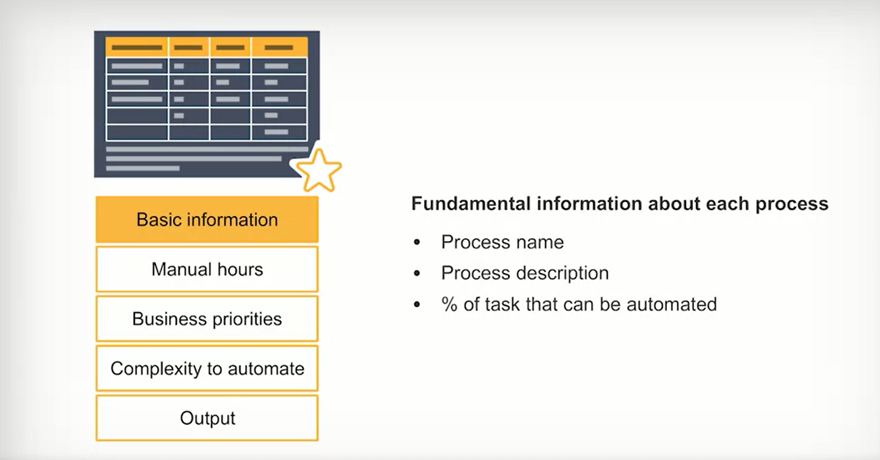
BASIC INFORMATION

Slide 14
MANUAL HOURS
In the manual hours section, you enter information pertaining to manual efforts of the employees working on the process. This includes the number of personnel in the process, number of hours per day that an employee is working on the process. Number of times per year that an employee works on the process, and average pay per hour of the employee engaged in this task.

Slide 15
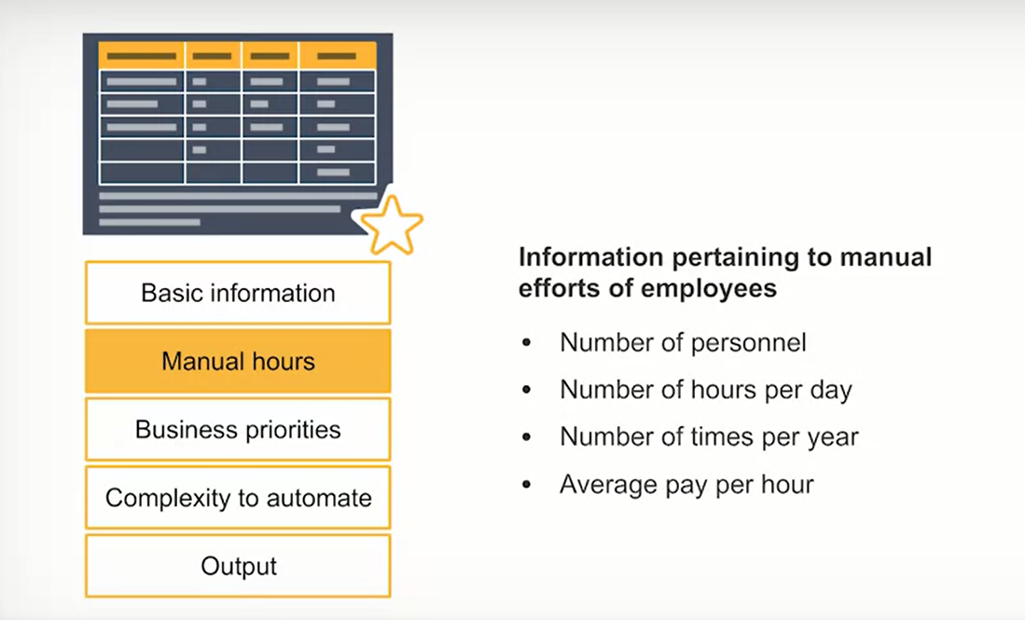
MANUAL HOURS

Slide 16
Business Priorities
Business priorities have already been identified in the top level benefit analysis. In the business priorities section of the brainstorm sheet, you rate the priority of each process on a scale of zero to five. Zero correlates to no business priority for that process. Five correlates to high business priority for that process. In between R1, low priority, and three, medium priority. In the complexity to automate section, you assign an estimated complexity of automating processes after analyzing them. A process can have either a low, medium or high complexity.

Slide 17
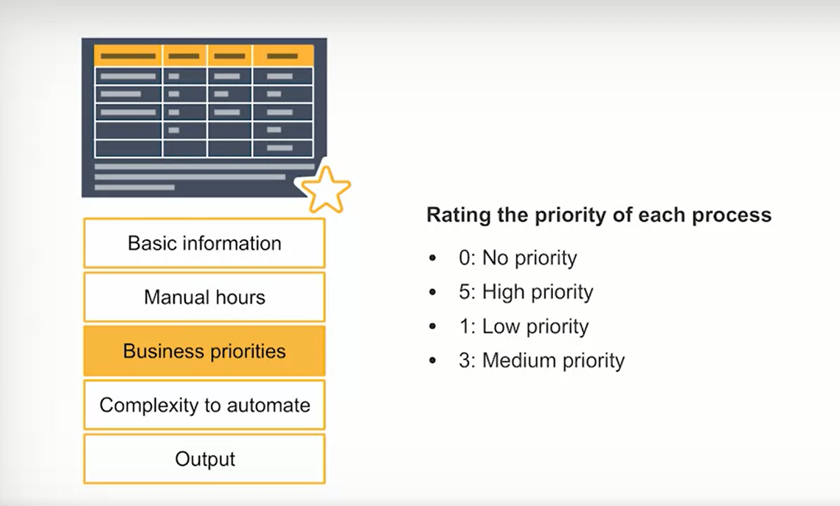
Business Priorities

Slide 18
Complexity to automate
In the complexity to automate section, you assign an estimated complexity of automating processes after analyzing them.
A process can have either a low, medium or high complexity.

Slide 19
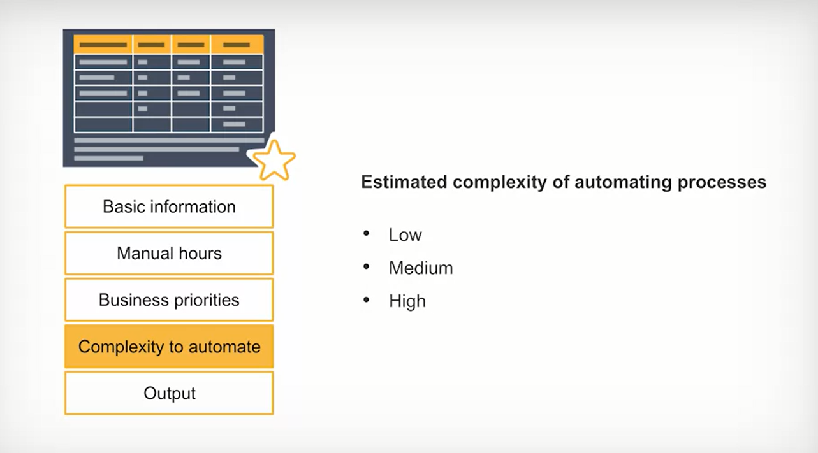
Complexity to automate

Slide 20
Output
The output section is the last section of the brainstorm sheet. It consists of information related to the outputs of the processes under consideration, and has three components.
The first component, business priorities percentage, tells you how closely aligned a process is to your organization's existing business priorities. A higher percentage indicates closer correlation.
The second component, manual dollars saved annually refers to the estimated annual dollar savings for your organization by automating a process.
The final component, hours saved annually helps you estimate the number of man hours your organization can save annually by automating this process.

Slide 21
Output
After analyzing processes on the basis of business priorities, you sort them. The processes are sorted in the sort sheet on the basis of business priority score, manual dollars saved score, or complexity to automate.
The sorting by business priority score ranks processes according to their respective alignment to business priorities. Similarly, sorting by manual dollars saved score ranks processes according to the quantum of cost reduction that follows if those processes were automated. And sorting by complexity ranks processes according to the complexity level, and requires you to take either business priority or manual dollars into account as well. You can view the graphical representation of all the processes after sorting as per both these criteria.
Please note that in the sorting stage efficiency and productivity are the main priorities. So that's how candidate prioritization can help Logix prioritize processes for automation. Now that the automation pipeline is complete, Logix will also have a better idea about continuing with Robotic Process Automation or RPA implementation.

Slide 22
Conducting Feasibility Analysis
Feasibility analysis for automating any process involves these five steps, gathering of resources, examining the process and noting down the steps, understanding the logic, checking for any elements that can prevent automation, and verifying elements that might require further testing.
Let's learn more about the first three steps of feasibility analysis.

Slide 23
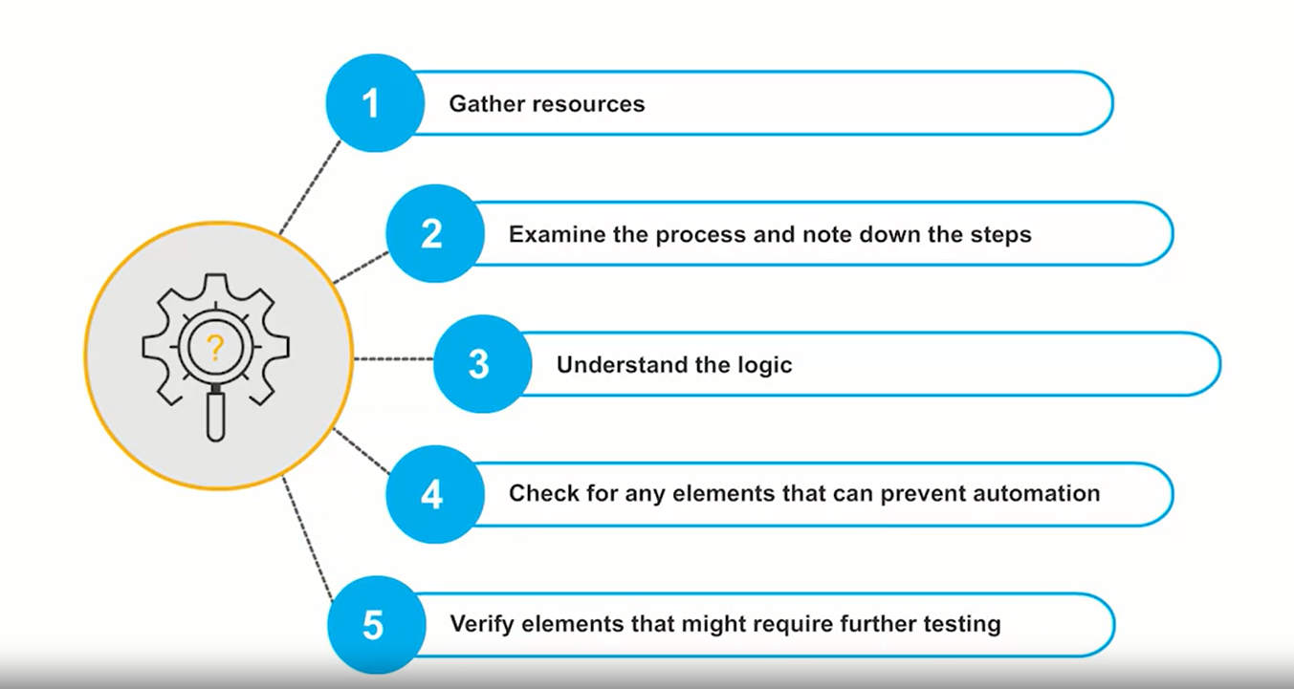
Conducting Feasibility Analysis

Slide 24
Step 1: Gather Resources
The first step in feasibility analysis is to gather or collect all resources associated with the process being studied. Some of these resources include, subject matter experts. These are the people who have designed the process.
Employees, these are the people who are familiar with the process and who perform or use the process. Hardware and software, these are the resources that are needed to carry out the process. For your analysis, you will need to examine the machines, equipment, or computer applications used to implement and execute the process.
Both human and non-human resources associated with the process, help you get reliable information about the nature of a process. After gathering the resources, it is crucial to understand how the process is currently carried out manually in your organization.

Slide 25
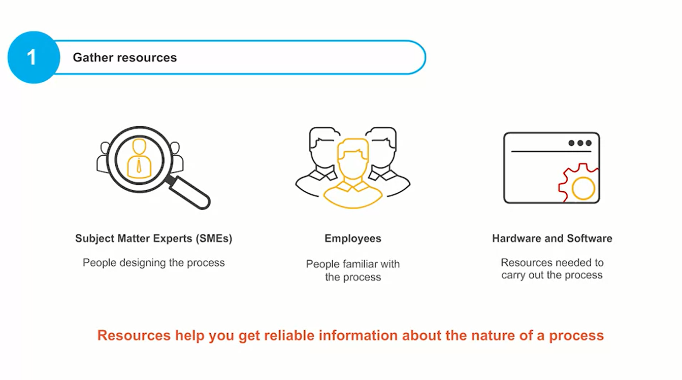
Step 1: Gather Resources

Slide 26
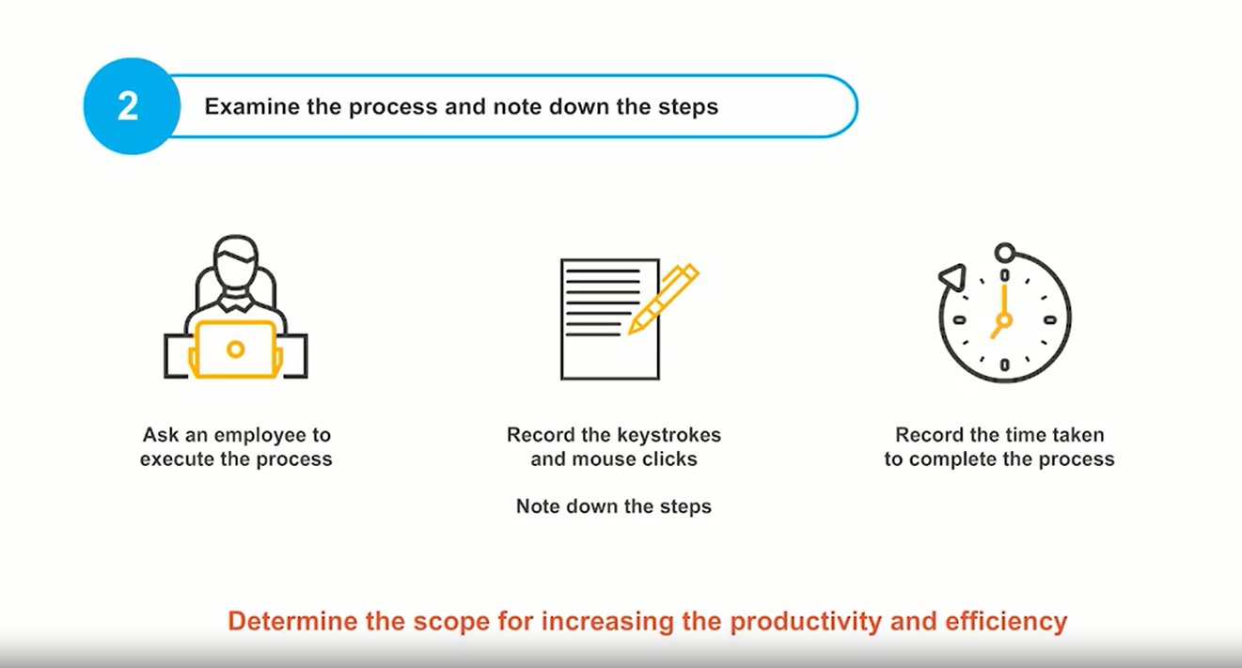
Step2: Examine the process and note down the steps

Slide 27
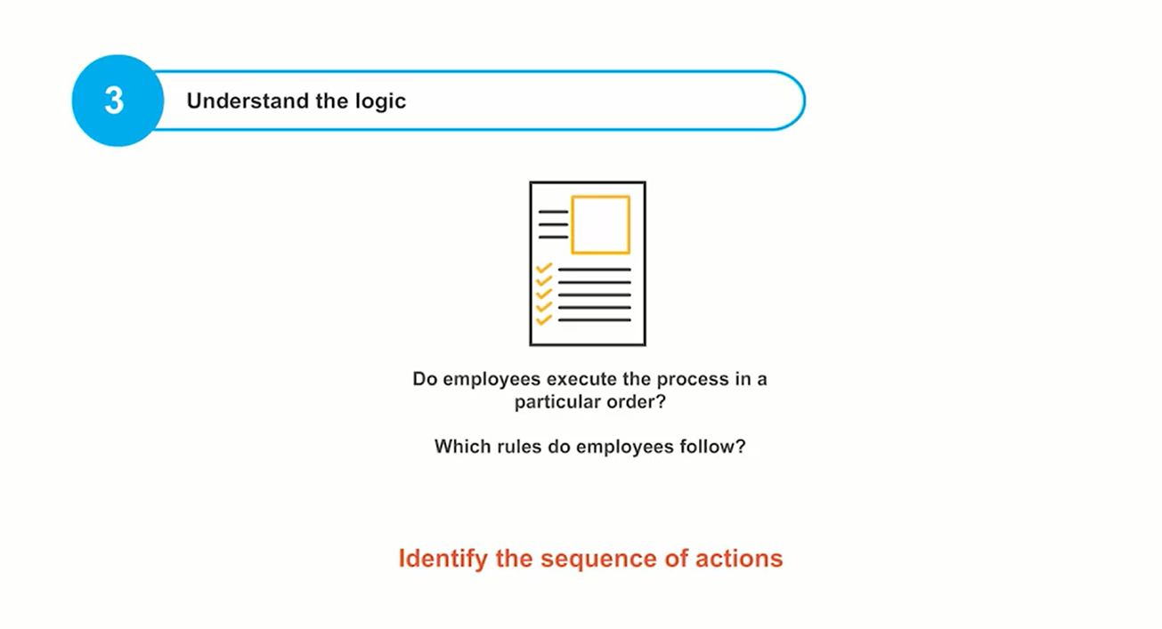
Step3: Understand the logic

Slide 28
Step4: Check for any element that might prevent automation
Let's see how they perform the last two steps. Checking for elements that might prevent automation is the fourth step of feasibility analysis. Processes that include elements such as judgment calls, fuzzy logic, handwritten documents, mandatory date pickers, and captcha codes prevent automation. For instance, if the process involves making decisions based on an employee's experience, it is not possible to automate the process. In the case of fuzzy logic, when a process involves steps that do not have a definite yes or no answer, it is difficult to automate the process. Processes involving handwritten documents cannot be automated either because automation cannot generate handwritten documents.

Slide 29
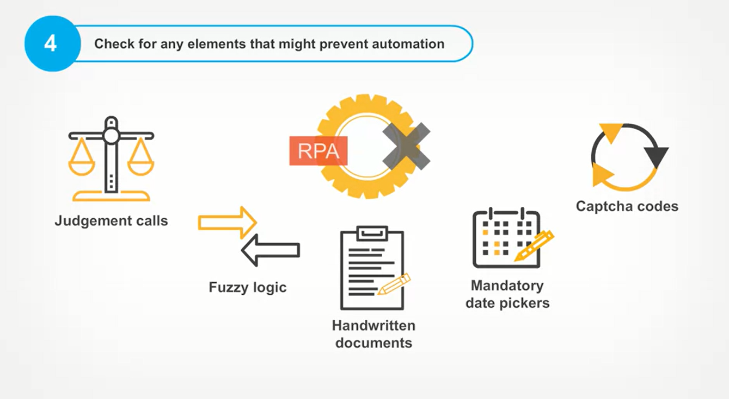
Step4: Check for any element that might prevent automation

Slide 30
Step4: Check for any element that might prevent automation
Similarly, if a process involves actions such as asking the employee to select dates from a given list of dates, and this choice depends on the employee's experience, it is difficult to automate it. What about captcha codes? Since captcha codes are basically used to prevent automation, a process that involves the entering of captcha codes cannot be automated.

Slide 31
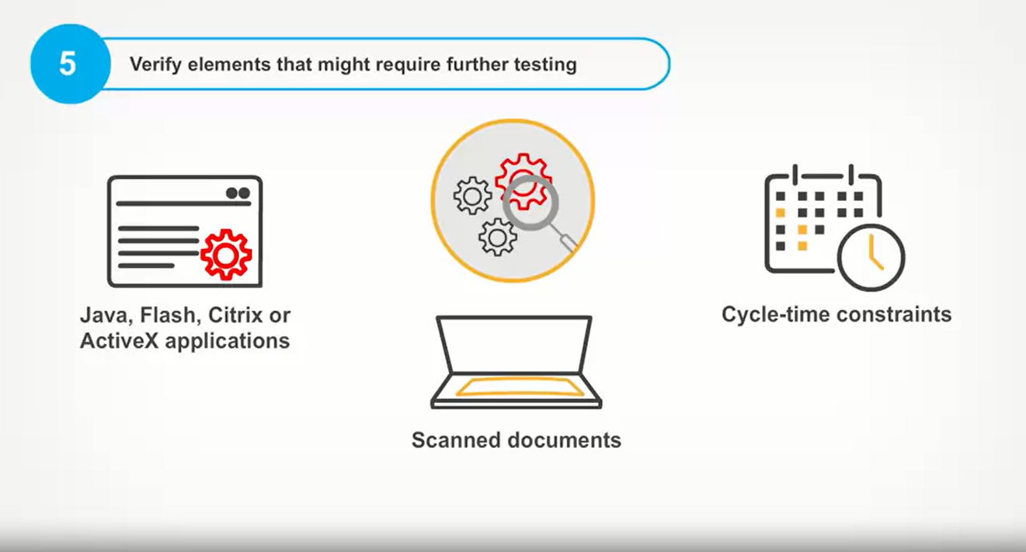
Step 5: Verify elements that might require further testing

Slide 32
Step5:Step 5: Verify elements that might require further testing
In the fifth and final step of feasibility analysis, you should verify if there are any elements in the process that might require additional testing before automating the process. Such elements include Java, Flash, Citrix or ActiveX applications, scanned documents, and cycle time constraints. Due to the nature of technologies such as Java, Flash, Citrix, or ActiveX applications, any programs or tools running applications based on these technologies will need further testing. Similarly, because optical character reader or OCR software is not 100 percent accurate, you might need manual intervention for analyzing scanned documents.
In cases step within a process needs to be completed within a certain amount of time or depends on inputs from other resources, it is difficult to automate the process directly. Further analysis will be needed before automating it. This completes the five steps of feasibility analysis.

Slide 33
Performing Complexity Assessment
Let's now explore the complexity calculator to understand how it is used. Let us go back to the example of the technology firm Logix. Here, the finance department is planning to automate few processes during the handling of salary slips, so that the department heads can plan the profit and loss or P&L better. To do this, you will first calculate the complexity of this automation task. To do so, you will need to gather some information on the process, this information is entered in the input metrics.
Let us see how Logix defines the input and output metrics. As you have just learned, the user input required section contains input metric fields.

Slide 34
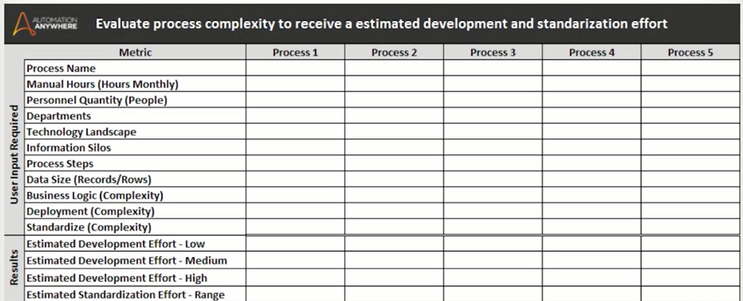
Performing Complexity Assessment (Input and Output Metrics)

Slide 35
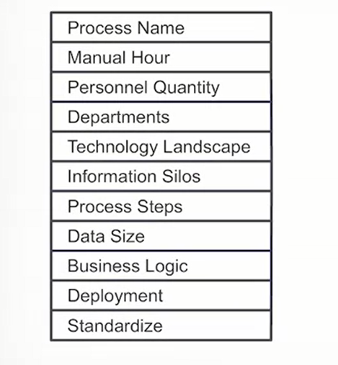
Input Metrics

Slide 36
Input Metrics
To begin, work with your team to find out the names of the processes that have been prioritized for automation.
Next, find out how many hours an employee spends on the process per month which is the manual hours.
For example, let us assume that an employee in the finance department at logix spends two hours per day on the process. Now, multiply this with the number of work days in a month, say 20, to determine the value for manual hours which will be 40 in this case, it's that simple.

Slide 37
Input Metrics
To find out the personnel quantity, find out how many employees perform the process task. This is typically a direct answer, but keep in mind that multiple computers with different environments may require automation task modifications or departments, find out how many different departments, teams, or groups, or stakeholders in the process.
This is simply the total number of departments involved like IT, HR, Operations, etc. But remember that multiple departments can create access and knowledge dependencies which may impact the automation timeline.

Slide 38
Input Metrics
Next, for the technology landscape, find out how many different types of technologies or applications are used for the process.
For example, if the process at Logix uses MS Excel, two databases, one email inbox, and three websites, the types of technologies or applications are four.
Note here that if Citrix is being used, you will consider a value of five.
For information silos, find out how many instances of each type of application or sub-application are used for the process.

Slide 39
Input Metrics
In the previous example, if four sheets of Excel are used, consider a value of four. The two databases would mean a value of six as each database carries a value of three.
One email inbox equals a value of one considering it as a dedicated inbox and say the three websites have two pages each, the value would be six. The information silos would then be the total which is 17.
Besides the database value, keep in mind these other special cases. If the email inbox is not dedicated, consider a value of 10. For websites and apps, consider instances of pages, as well as pop-up windows.
If Citrix, Flash, or ActiveX is used, add a value of 21. For an accurate evaluation of websites, have an automation expert test it. If the word or PDF documents vary, consider a separate automation for each situation.

Slide 40
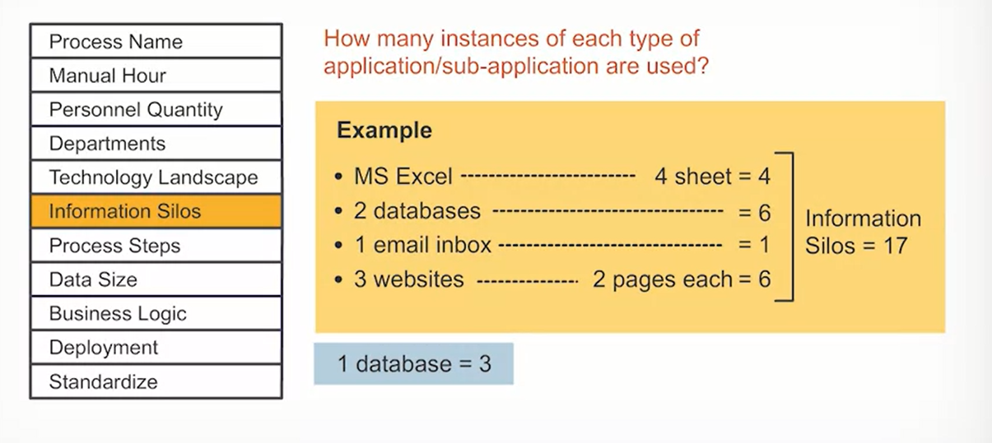
Input Metrics

Slide 41
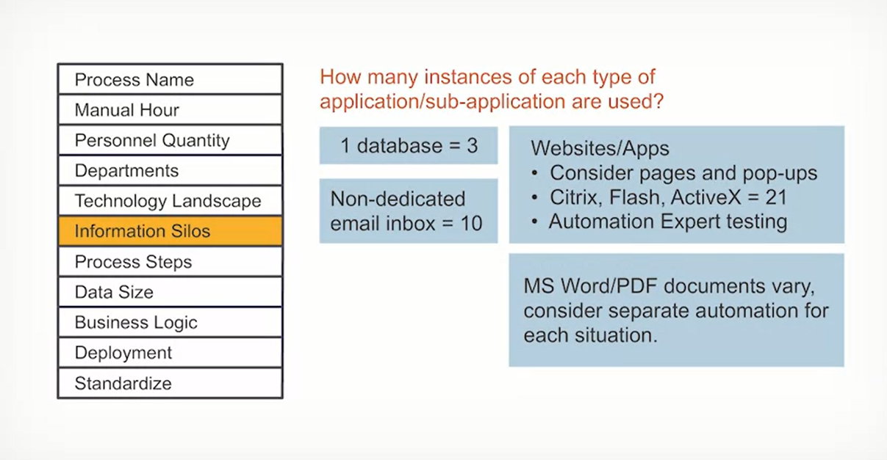
Input Metrics

Slide 42
Input Metrics
Next, for process steps, find out how many fields is data being extracted from and/or inputted to.
For example, if you're pulling data from 10 fields of a website page and 100 Excel columns and entering data into 23 website fields, the process steps will be the total, that is 133.

Slide 43
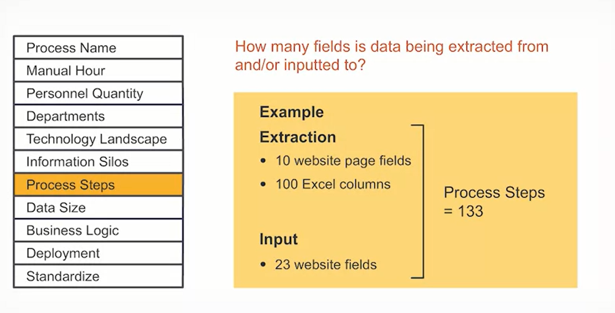
Input Metrics

Slide 44
Input Metrics
To check the data size, find out how many rows or records of data are being processed and how many times the loop is running. This is simply the total number of data rows at any tabular format or records in any database. The file size impacts this metric. For files with size 10 to 20 megabytes, data size will fall between 501 and 2,000.
For files with size larger than 20 megabytes, data size will be greater than 2,000. For files larger than 75 megabytes or with rows more than 5,000, consider additional development time or system configurations. You can always use parsing technique to split large files into smaller subsets.

Slide 45
Input Metrics
The last three input metrics: business logic, deployment, and standardized are less about performing accurate calculations and more about making sound judgments.
For business logic, you will determine how much logic is required for automation and how complicated it is.
More specifically, you have to determine the complexity level of the business logic for the automation.
If it is low, medium, or high. For this, wherever applicable, you should consider complexity sub-levels of various factors like if conditions, real-time scenarios, automation type, fixed versus dynamic aspects, and process cycle time.

Slide 46
Input Metrics
Here are the details for each factor. The if condition is used when you want to execute a set of activities only when a certain condition exists or is fulfilled.
These conditions can be basic and simple with a low complexity level. You can also create a more complex condition by adding several branches to simultaneously evaluate more than one condition.
If there is a possibility of undefined real-time scenarios, then the complexity level is high. If the automation type is end state the complexity is low, but it becomes high for stage by stage automation. Finally, the complexity level remains medium for both fixed file formats and dynamic file names and locations. For a firm process cycle with time constraints, the complexity is either medium or high.

Slide 47
Input Metrics
For deployment, determine how complex the rollout is, that is what is the complexity level of automation deployment?
Low, medium or high? For this metric as well wherever applicable, consider complexity sub-levels of various factors like quality assurance, development and live environments, push updates, and time and access restrictions. These factors along with system updates will also impact timelines and required task modifications.
Here are the details for each factor. If the same QA environment is used in the development, the rollout complexity is medium. If the QA environment is different from the live environment, the complexity level can be medium or high.
If the development and deployment machines are different, the complexity ranges from medium to high. For deployment machines that are informed in advance about the push updates, the complexity is medium.

Slide 48
Input Metrics
Whereas for such machines that are uninformed about the updates, the complexity level raises too high. In cases of time restricted deployment, the complexity is medium to high. But when there is restricted access to development machines, the rollout complexity level is high. Finally, for standardized, determine how long it will take to define and standardize the process for automation development, that is what is the complexity level of standardization? Low, medium or high?
For this metric as well, wherever applicable, consider complexity sub-levels of various factors like the existence of process steps and logic, automation friendliness of process files, and compliance regulations. Here are the details for each factor. For automation development, if the process steps and logic are defined and documents, the complexity level of standardization is low. This level increases to medium if these steps are defined, but not documented.

Slide 49
Output Metrics
Once the input metrics are defined, three values are generated for the estimated development effort, low, medium, and high, and an effort range is generated for standardization.
So that's how the complexity calculator helps organizations like Logix to estimate automation efforts required and plan likewise.

